Slide 1
Image-Based Situation Awareness Audit XX.5.2018
Sakari Lampola

Slide 2
Previous Audit 28.2.2018

Slide 3
Previous Audit

Slide 4
Project Plan

Slide 5

Project Plan
Methodology / Preparation of research infra
Software platforms are constructed and tested
Off-the-shelf models are acquired and tested
Necessary skills on platforms are learned
Methodology / Method survey
Current state-of-art methods are studied
Methods are constructed and tested on the software platforms
Method follow-up
Screening of conference papers related to the subject
Possibly integrating new methods to the project

Slide 6
Work Done

Slide 7
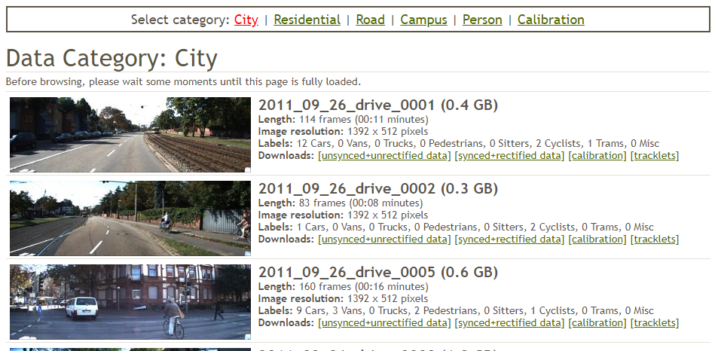
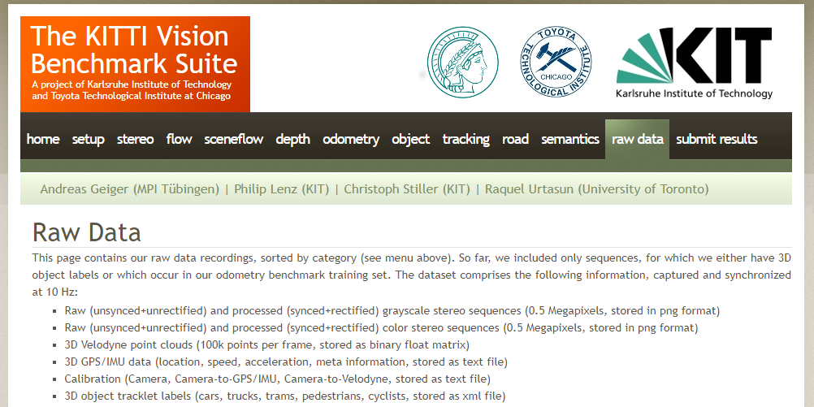
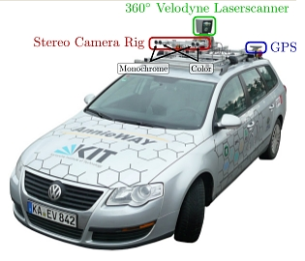
Specification:
Video
Stereo
Distance information
Outdoor + indoor
Odometry
Dataset Selection
Open question: Indoor? Self generated?

Slide 8
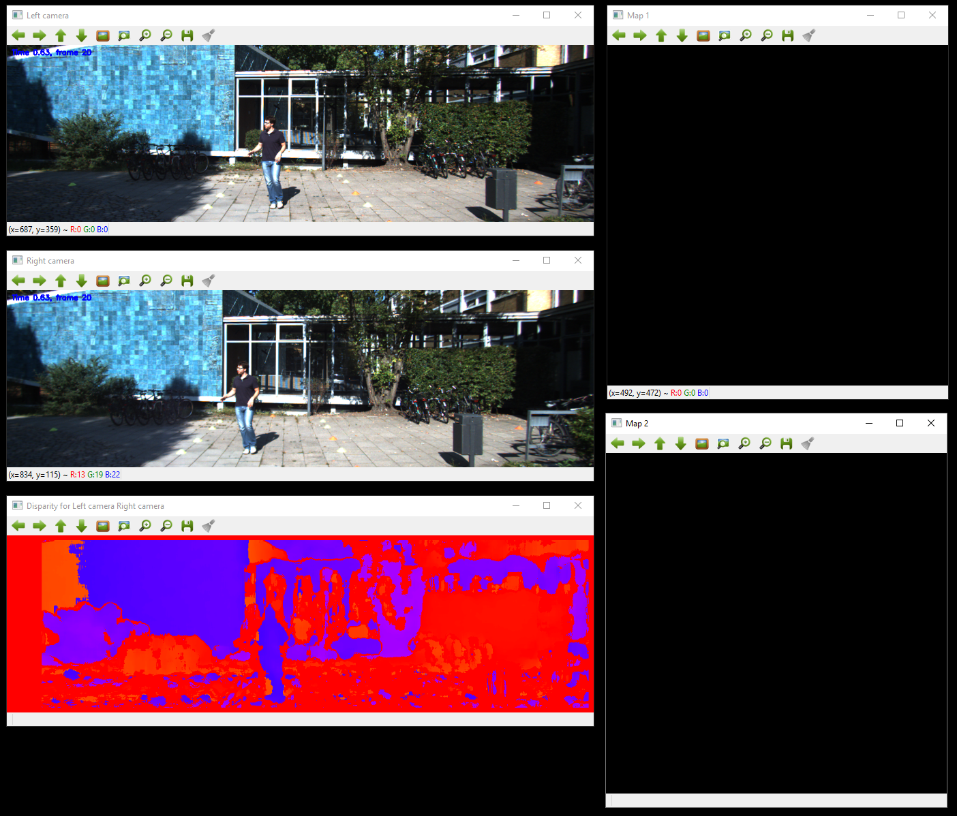
Software version 2.1 – Support for KITTI and stereo
Dataset Selection
No object detection!

Slide 9
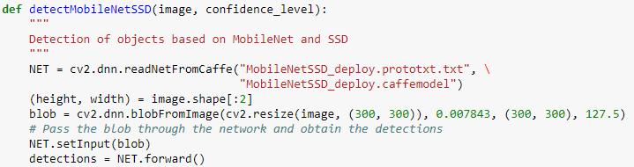
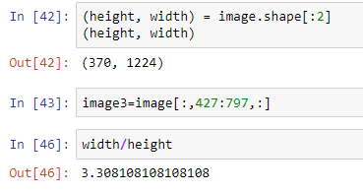
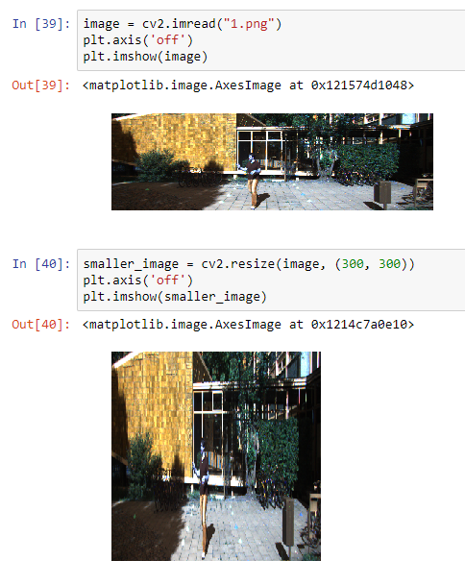
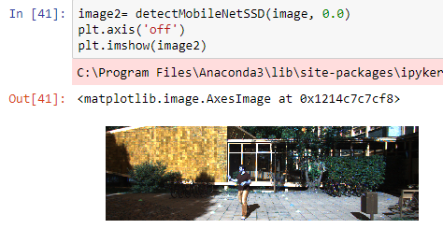
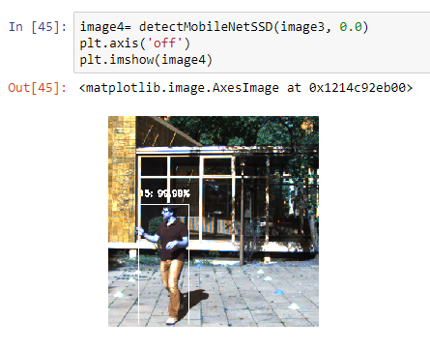
Image is resized to 300*300 pixels
Dataset Selection

Slide 10
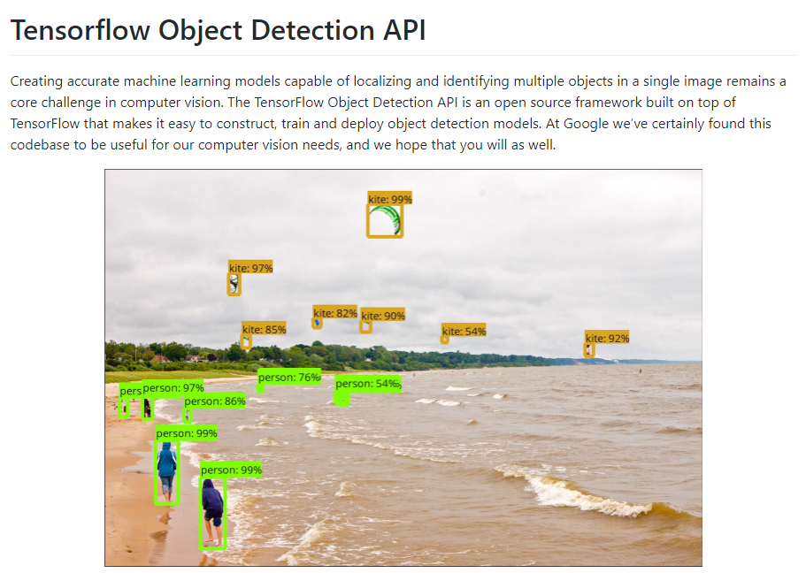
Resized KITTI image is too deformed to be useful. We need another network implementation!
Dataset Selection
https://github.com/tensorflow/models/tree/master/research/object_detection

Slide 11
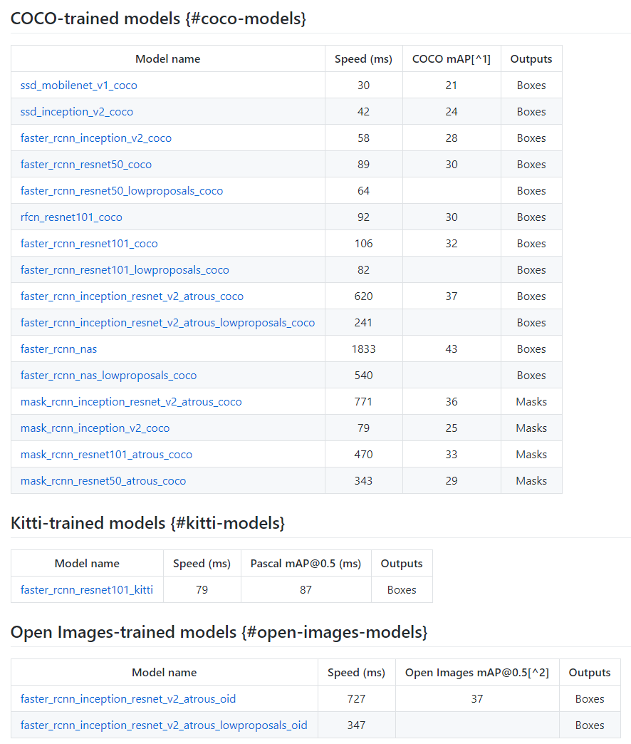
Dataset Selection
One of these will be the final model.
Lottery prize!!!! Will be used next to fix localization, velocity estimation and stereo.

Slide 12

Dataset Selection

Slide 13
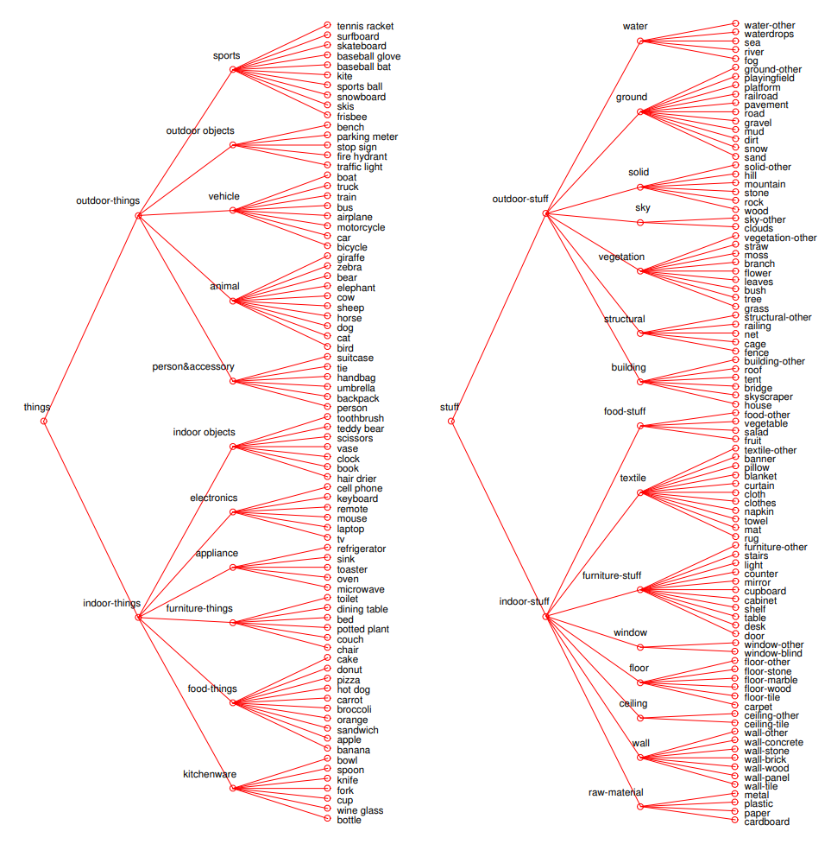
Dataset Selection

Slide 14
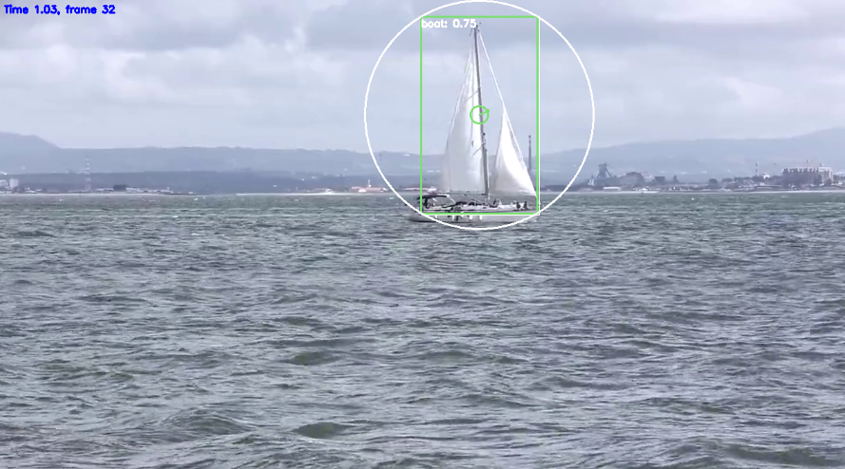
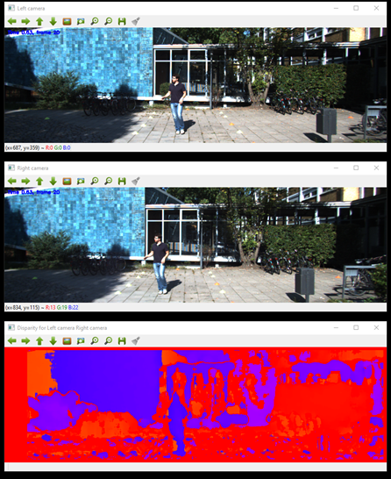
Left
Right
Stereo Vision
disparity d

Slide 15
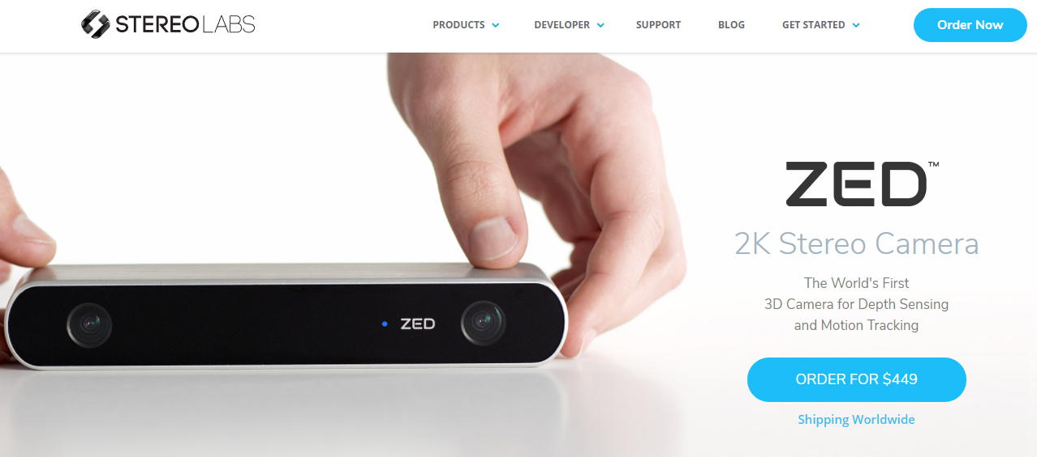
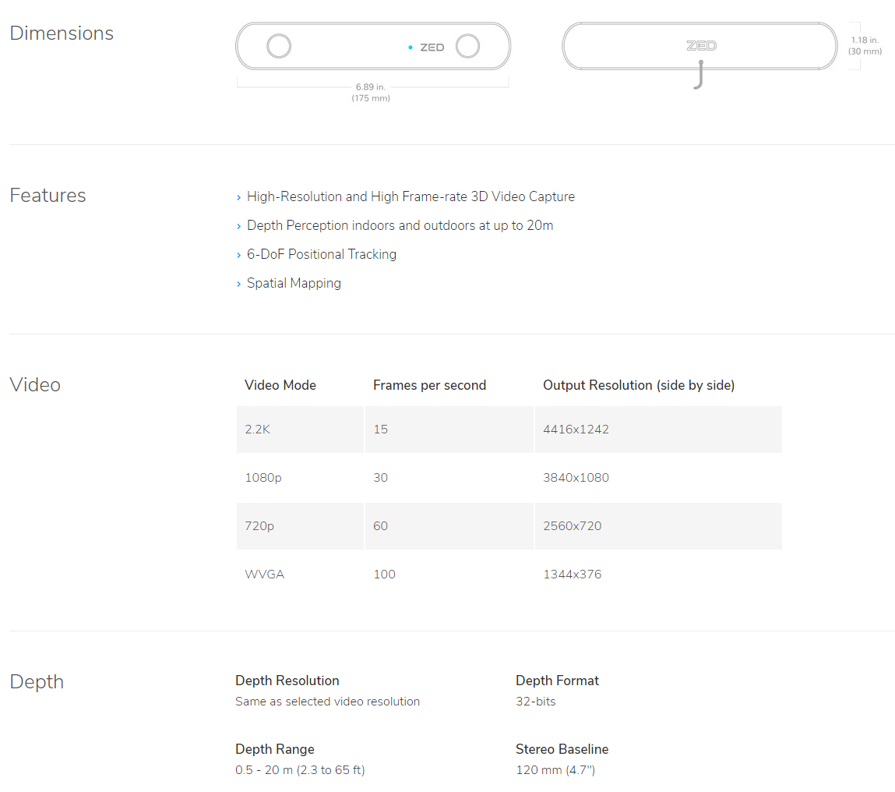
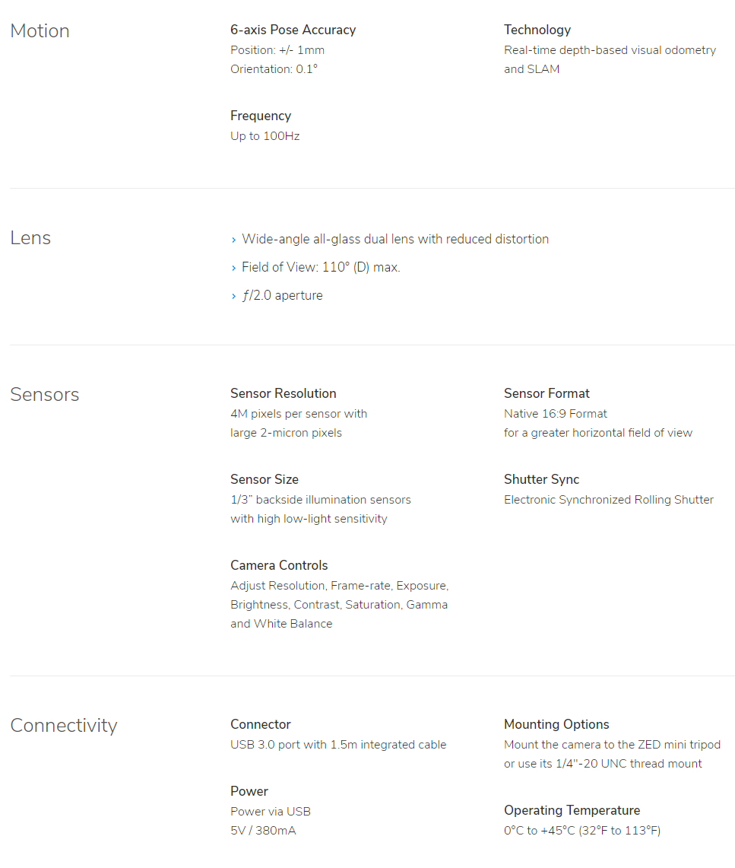
Stereo Vision

Slide 16
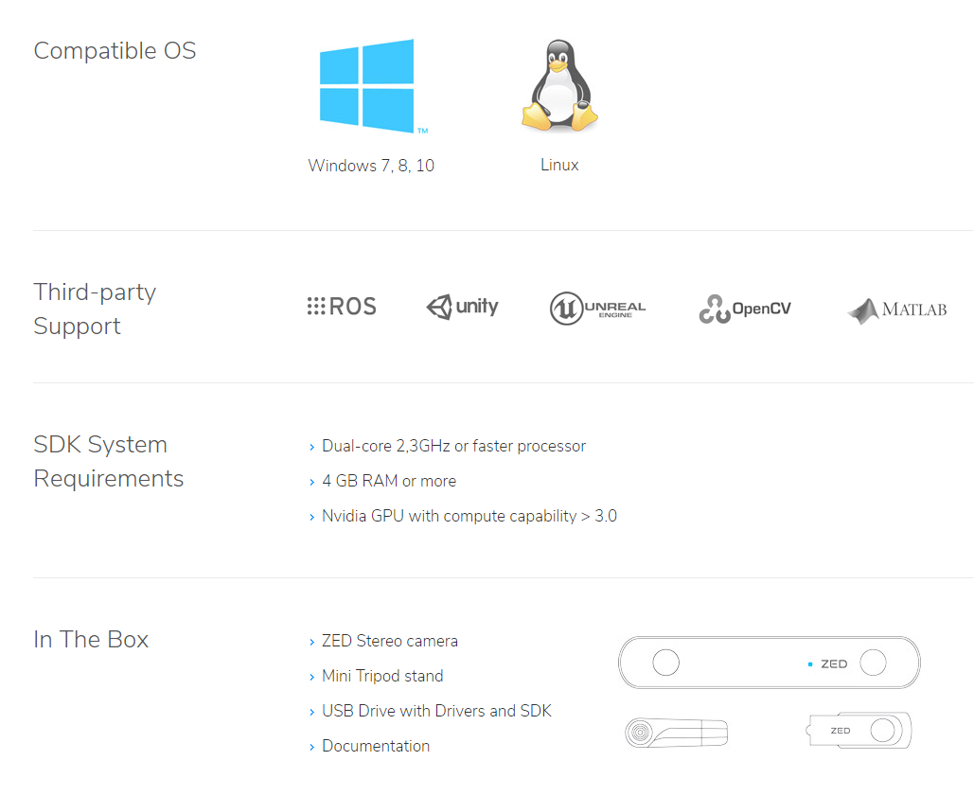
Stereo Vision

Slide 17
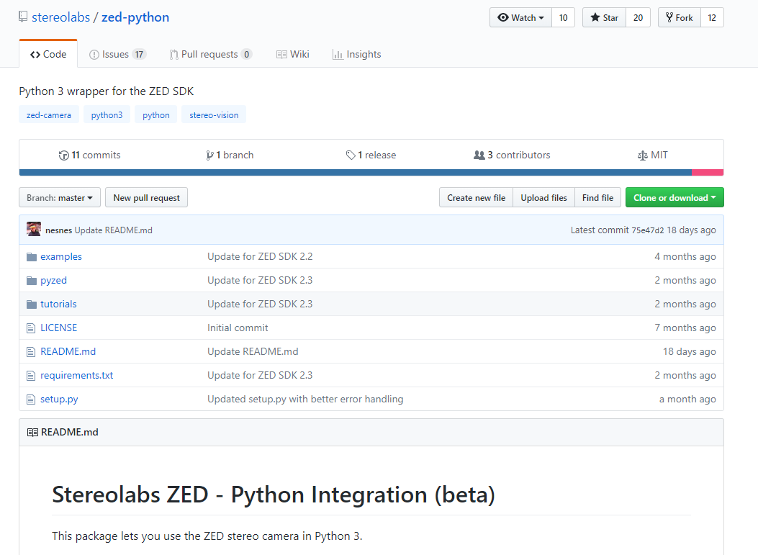
Stereo Vision

Slide 18
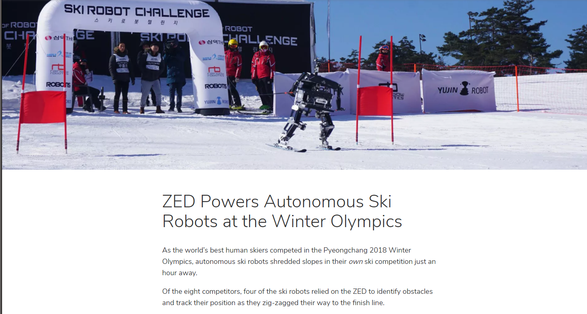
Stereo Vision
☺

Slide 19
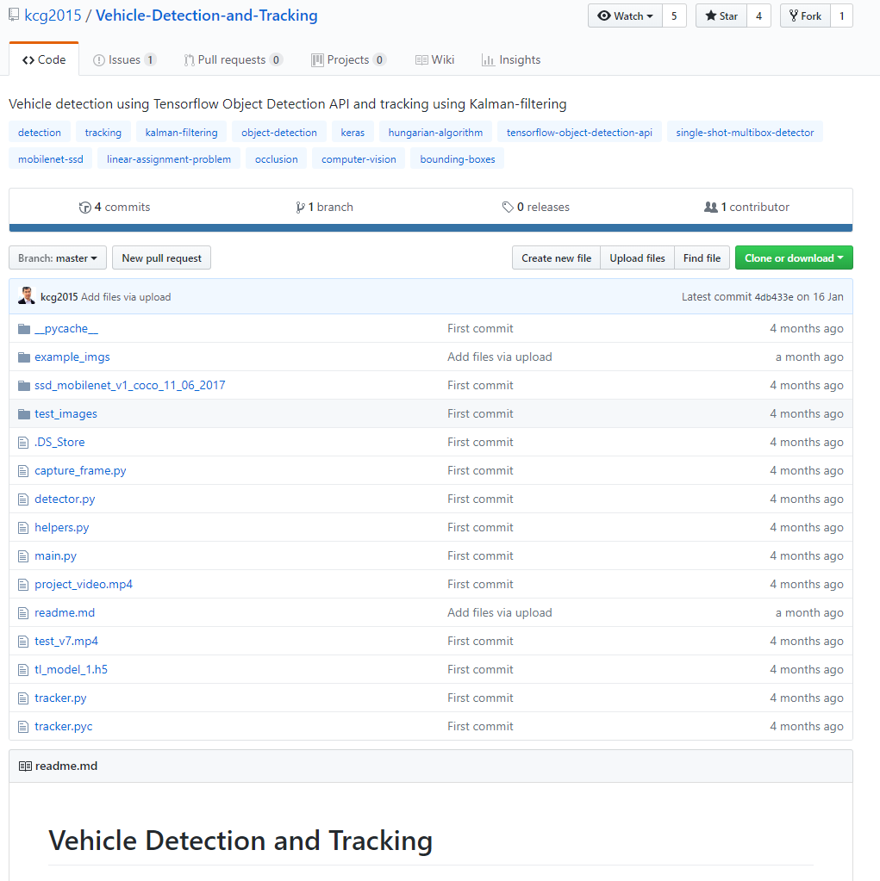
Kalman Filter Parameter Adjustments
https://github.com/kcg2015/Vehicle-Detection-and-Tracking

Slide 20
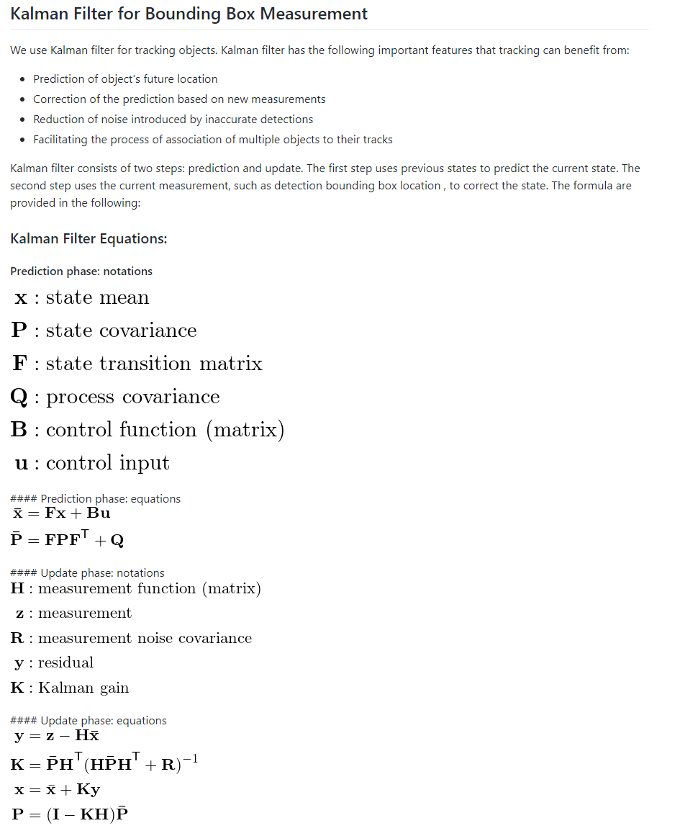
Kalman Filter Parameter Adjustments

Slide 21
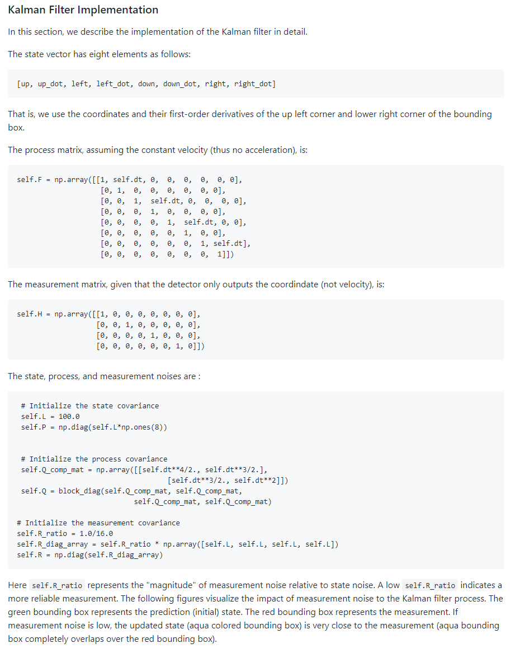
Kalman Filter Parameter Adjustments

Slide 22
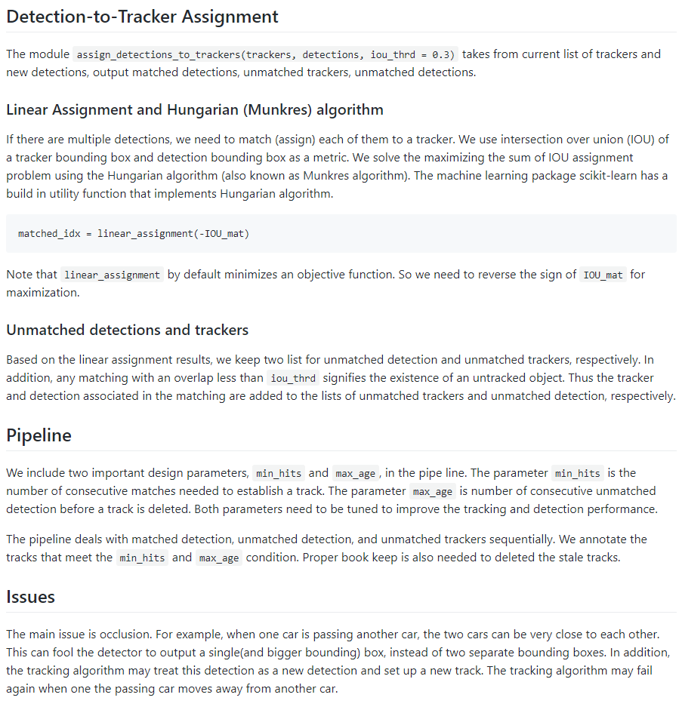
Kalman Filter Parameter Adjustments

Slide 23
The Big Picture

Slide 24
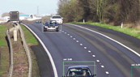
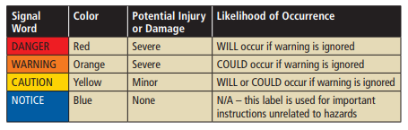
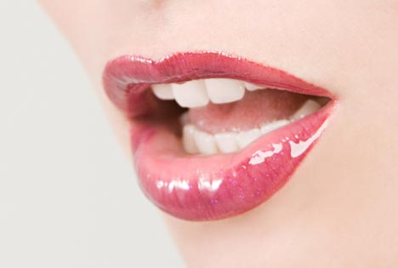
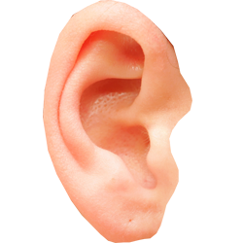
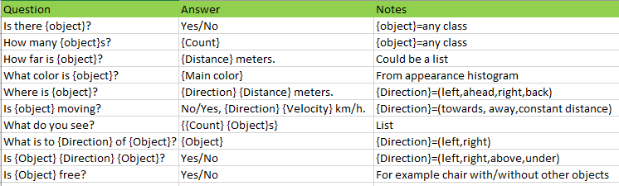
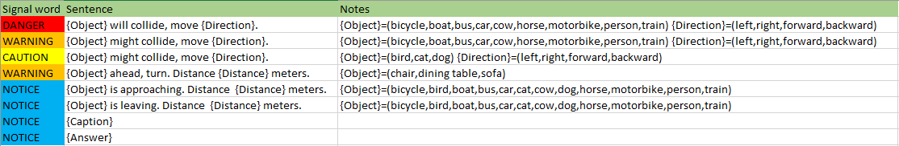
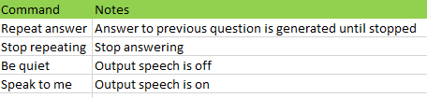
Matching
Pattern filtering
Distance estimation
3D projection
Body filtering
Body prediction
Collision detection
…
CNN + Object Detection
Semantic Segmentation
Visual Analysis
Bodies (+attributes)
Context
Forecasts
Collision probabilities
Other representations
Voice
High female
Low female
High male
Low male
Stereo Vision
Commands Questions
Speech Generation
Speech Synthesis
Words per minute: max 150…160
Priority queue, active dropping
Speech Recognition
Speech Analysis
Q/A: (Answer voice: NOTICE)
Syntactic classification
Semantic classification
Generated based on situation:
Commands:

Slide 25
Next Steps

Slide 26
Kalman filter parameter adjustments (Q1)
Dataset selection (Q1)
Stereo vision (Q2)
Camera yaw, pitch, roll estimation (Q2)
Speech recognition (Q2)
Semantic segmentation (Q2)
Experiments in the wild (Q2)
Paper (Q3)
Speech analysis (Q3)
Speech generation (Q3)
Use cases (Q4)
Next steps

Slide 27
Discussion

Slide 28
Thank you!
lampola@student.tut.fi
https://github.com/SakariLampola/Thesis

